Slide 1
Cybersecurity Insights
Exploratory Data Analysis and Visualization COM SCI X 450.2 Final Presentation
Alley Hernandez Allison Bajo

Slide 2
Introduction
Course Integration
We will apply various topics discussed throughout the course
Data Analysis Requirements:
We will be analyzing 4 different datasets
CSIS(International), IC3 Summary, IC3 States, Canadian Anti-Fraud Centre
Dataset Merging
We have merged many different datasets
IC3 States 2021 and 2022 combined together, then merged with Canadian Data
Merged all 16 IC3 summary reports into one big report. Did this merge outside of R

Slide 3
Research Question
How have cyber attacks patterns changed over the years?

Slide 4
Project Workflow
1
Data Collection and Understanding
2
Data Cleaning and Manipulation
3
Exploratory Data Analysis

Slide 5
Data Sets and Sources

Slide 6
Significant Cyber Incidents
This CSIS tracks major cyber incidents from 2003 - 2022
Focus is on attacks against governments, defense, tech firms, and big economic crimes
Only includes crimes with losses over a million dollars
Aims to identify impactful cyber threats and trends
Data helps understand risks to critical sectors and national security
The dataset is used for strategic analysis of cybercrime patterns
Information assists in policy-making and cybersecurity measures
01
Data Description:
continent: Continent of Origin​
country: Country of Origin​
month: Month of Cyber Incident​
year: Year of Cyber Incident​
type: Type of Cyber Incident​
category_id: ID of the Cyber Incident Category (category level)
947 rows
6 columns​
Significant Cyber Incidents Dataset
https://www.kaggle.com/datasets/javaidiqbal198/significant-cyber-incidents-dataset/data
Taken from here https://www.csis.org/programs/strategic-technologies-program/significant-cyber-incidents

Slide 7
Data Sets
FBI Internet Crime Report
IC3 US Report 2006-2022
Yearly Crime Report 2015-2022
01
Data Description:
Overall US Cyber Crime data
Provides trends into the number of attacks and the cost to those attacks
17 rows (2006 – 2022 summary data)
FBI Internet Crime Report
IC3 US Report 2006-2022
02
Data Description:
Overall US Cyber Crime Type data
Categorized Cyber Crime attacks with related frequency and cost
259 rows (~31 entries for each year 2015 - 2022)
FBI Internet Crime Report Yearly Crime Report 2015-2022
https://www.ic3.gov/Home/AnnualReports

Slide 8
IC3 USA State Report 2021
01
Crime Type by Victim Count
Data Description:
State: State Affected
Crime Type: Type of Cyber Crime
Victim Count​: Number of Victims Affected
1,767 rows (31 entries for 57 states and territories)
3 columns
IC3 gives information on many cybercrimes
It counts victims to show which cyber crimes happen most
It shows how much money people lose from each cybercrime
It counts how many criminals do these cybercrimes
It tracks money lost to each kind of criminal
It checks which ages get hit by cybercrime the most
The data's rightness depends on people's reports to IC3
IC3 looks at a lot of data from 57 states and territories
IC3 makes sure all the crime data is correct
The info helps lots of people understand cybercrime
02
Crime Type by Victim Loss
Data Description:
State: State Affected
Crime Type: Type of Cyber Crime
Loss Amount: Amount of Money Loss
1,767 rows (31 entries for 57 states and territories)
3 columns
03
Crime Type by Subject Count
Data Description:
State: State Affected
Crime Type: Type of Cyber Crime
Subject Count​: Number of Subjects Affected
1,767 rows (31 entries for 57 states and territories)
3 columns
04
Crime Type by Subject Loss
Data Description:
State: State Affected
Crime Type: Type of Cyber Crime
Loss Amount: Amount of Money Loss
1,767 rows (31 entries for 57 states and territories)
3 columns
05
Victims by Age Group
Data Description:
State: State Affected
Age Range: Age Range of Victims Affected
Count: Number of Victims in Age Group
Amount Loss: Amount of Money Loss
342 rows (6 entries for 57 states and territories)
4 columns
https://www.ic3.gov/Media/PDF/AnnualReport/2021State/StateReport.aspx#?s=1

Slide 9
IC3 USA State Report 2022
01
Crime Type by Victim Count
Data Description:
State: State Affected
Crime Type: Type of Cyber Crime
Victim Count​: Number of Victims Affected
1,767 rows (31 entries for 57 states and territories)
3 columns
IC3 gives information on many cybercrimes
It counts victims to show which cyber crimes happen most
It shows how much money people lose from each cybercrime
It counts how many criminals do these cybercrimes
It tracks money lost to each kind of criminal
It checks which ages get hit by cybercrime the most
The data's rightness depends on people's reports to IC3
IC3 looks at a lot of data from 57 states and territories
IC3 makes sure all the crime data is correct
The info helps lots of people understand cybercrime
02
Crime Type by Victim Loss
Data Description:
State: State Affected
Crime Type: Type of Cyber Crime
Loss Amount: Amount of Money Loss
1,767 rows (31 entries for 57 states and territories)
3 columns
03
Crime Type by Subject Count
Data Description:
State: State Affected
Crime Type: Type of Cyber Crime
Subject Count​: Number of Subjects Affected
1,767 rows (31 entries for 57 states and territories)
3 columns
04
Crime Type by Subject Loss
Data Description:
State: State Affected
Crime Type: Type of Cyber Crime
Loss Amount: Amount of Money Loss
1,767 rows (31 entries for 57 states and territories)
3 columns
05
Victims by Age Group
Data Description:
State: State Affected
Age Range: Age Range of Victims Affected
Count: Number of Victims in Age Group
Amount Loss: Amount of Money Loss
342 rows (6 entries for 57 states and territories)
4 columns
https://www.ic3.gov/Media/PDF/AnnualReport/2022State/StateReport.aspx#?s=1

Slide 10
Canadian Anti-Fraud Centre Fraud Reporting System Dataset 2021 - 2022
The Canadian Anti-Fraud Centre collects scam reports from the public
Report accuracy varies with who is reporting
Analysts check each report for correctness
Information is offered in both French and English
01
Data Description:
Number ID
Date Received: Date Report was Received
Complaint Received Type: Type of Complaint
Country: Country Affected
Province/State: State or Territory Affected
Fraud and Cybercrime Thematic Categories: Type of Crime
Solicitation Method: Type of Solicitation Method
Gender: Gender of Victim
Language of Correspondence: Language Reported
Victim Age Range: Age Range of Victim
Complaint Type: Type of Complaint
Number of Victims: Amount of Victims
Dollar Loss: Money Lost
248,764 rows
21 columns
Canadian Anti-Fraud Centre Reporting Data
https://open.canada.ca/data/en/dataset/6a09c998-cddb-4a22-beff-4dca67ab892f

Slide 11
Data Cleaning

Slide 12
Significant Cyber Incidents: Incident Trends (2003-2022) Data Cleaning and Manipulation​​
Step 1
Step 2
Step 3
Step 4
Step 5
Step 6
Opened CSV file in Excel Desktop app​
Sorted Numerical Data into Ascending Order
Checked for mistakes in the Numerical Data
Sorted other Data into Alphabetical Ascending Order
Checked for spelling mistakes​
Checked for geographical mistakes​
Understanding our Cleaned Data:
Edited mistakes manually in Excel
All columns had complete data, so none were removed
We found 57 repeated records but kept them
We fixed all the misspelled words in our data
We corrected wrong continent names for each country
We also fixed wrong country names listed under continents
We removed entries that were not countries, like territories or ethnic groups
826 rows and 5 columns​

Slide 13
Data Cleaning
FBI Internet Crime Report
FBI Internet Crime Report is fairly complete with no missing data.
However the yearly categorizations varied and that is where the data was modified to align the values.
The FBI data lacks details and is provided in an aggregated manner so this report attempts to gain insight from the data rather than characterize the different types of attacks in depth.
Also missing is the methodology in the data gathered. Some cyber attacks are not used in isolation but in combination. This report does not attempt to cover the “attack chain”.

Slide 14
IC3 USA State Report 2021-2022
Data Cleaning and Manipulation​​
Step 1
Step 2
Step 3
Step 4
Step 5
Visited IC3 website
Checked each State Report 1 by 1
Focused on phishing, number of victims, and their losses
Entered data manually into excel
Converted to .csv
Understanding our Cleaned Data:
Visited the IC3 website.
Entered data into Excel by hand because downloading was not an option.
Decided to look at just 2021 and 2022 data.
Concentrated on phishing, number of victims, and their losses.
50 rows and 6 columns

Slide 15
Canadian Anti-Fraud Centre Fraud Reporting System Dataset 2021-2022
Data Cleaning and Manipulation​​
Step 1
Step 2
Step 3
Step 4
Step 5
Step 6
Opened Excel file in Excel Desktop app​
Sorted Numerical Data into Ascending Order
Filtered Data for only Canada
Filtered Data to Exclude Canadian Territories
Deleted French Columns
Filtered to only include phishing entries
Understanding our Cleaned Data:
Edited manually in Excel
All columns had complete data, so none were removed
Removed entries for other countries except Canada
Removed entries for Canadian territories
Removed columns in French
Removed entries that were not for phishing
3535 rows and 6 columns​

Slide 16
Phishing Incident Report: Victim Counts and Financial Losses in the United States and Canada (2021-2022)
Data Cleaning and Manipulation​​
Step 1
Step 2
Step 3
Step 4
Step 5
Opened Canada and USA Excel file in Excel Desktop app​
Sorted Numerical Data into Ascending Order
Combined Data for USA and Canada into one Excel
Combined 2021 and 2022 data together
Converted into CSV
Understanding our Cleaned Data:
Edited manually in Excel
120 rows and 6 columns​

Slide 17
EDITED: Adding USA and Canada 2021 and 2022 Population to Phishing Incident Report: Victim Counts and Financial Losses in the United States and Canada (2021-2022)
Searched the internet for population data for USA and Canada respectively
Found information on various cites including:
https://www.census.gov/data/tables/time-series/demo/popest/2020s-state-total.html
https://en.wikipedia.org/wiki/Population_of_Canada_by_province_and_territory
https://worldpopulationreview.com/canadian-provinces
USA population by state was available in a .csv so used the population estimates of 2021 and 2022 and added them to the ‘usaCanada’ .csv (AKA Phishing Incident Report: Victim Counts and Financial Losses in the United States and Canada (2021-2022))
Canada population by state was not available as a .csv so manually placed them onto excel. This population estimate information was added to the ‘usaCanada’ .csv (AKA Phishing Incident Report: Victim Counts and Financial Losses in the United States and Canada (2021-2022))
Understanding our Cleaned Data:
Edited manually in Excel
120 rows and 7 columns​

Slide 18
Summary Statistics

Slide 19
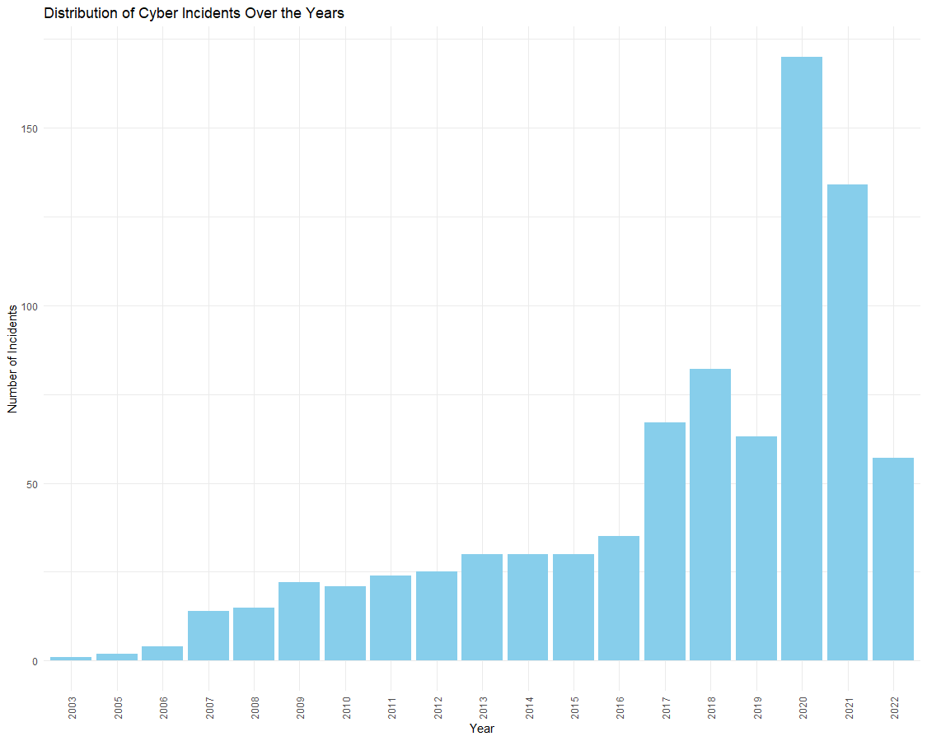
Significant Cyber Incidents: Incident Trends (2003-2022)
The chart shows rising cyber incidents from 2003 to 2022
Incidents have gone up over time, with the most in 2021
The chart highlights bigger cyber security problems
More incidents might mean people are reporting more
The CSIS chart shows we need better cyber defenses
It could help argue for more money in cyber security

Slide 20
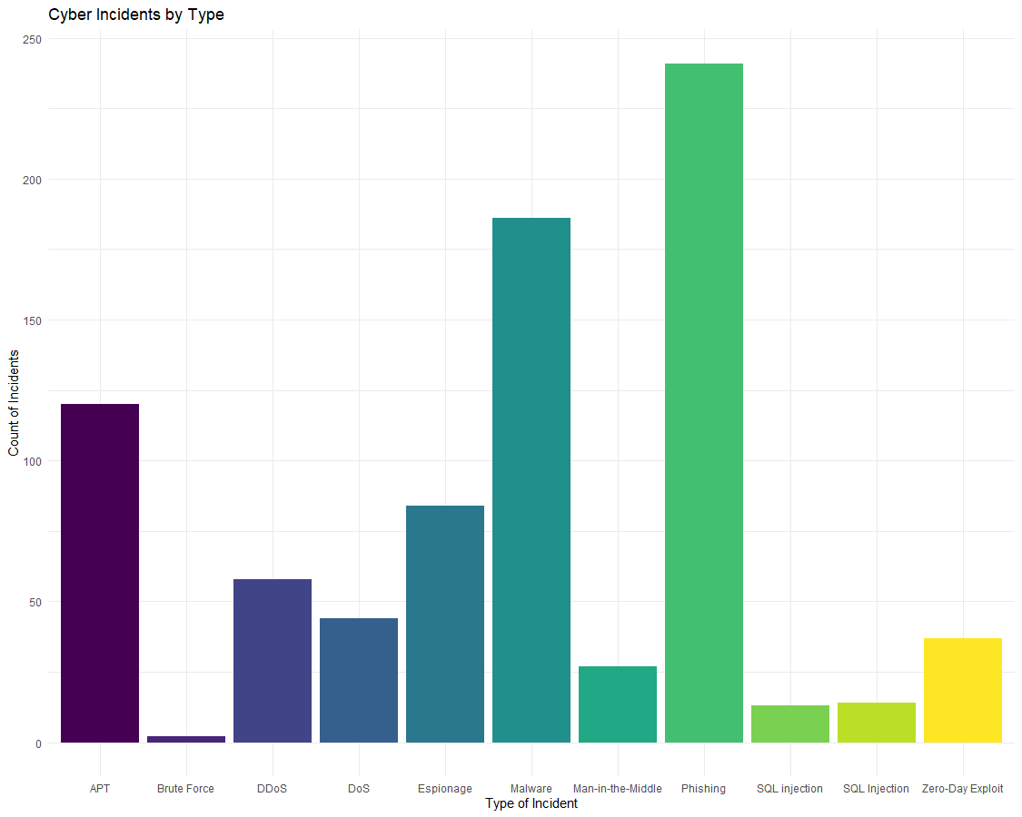
Significant Cyber Incidents: Incident Trends (2003-2022)
The chart shows cyber attack types from 2003 to 2022
Phishing is the most common cyber threat
APT and malware attacks happen a lot
There are many DDoS and DoS attacks too
SQL Injection and Brute Force are the least common

Slide 21
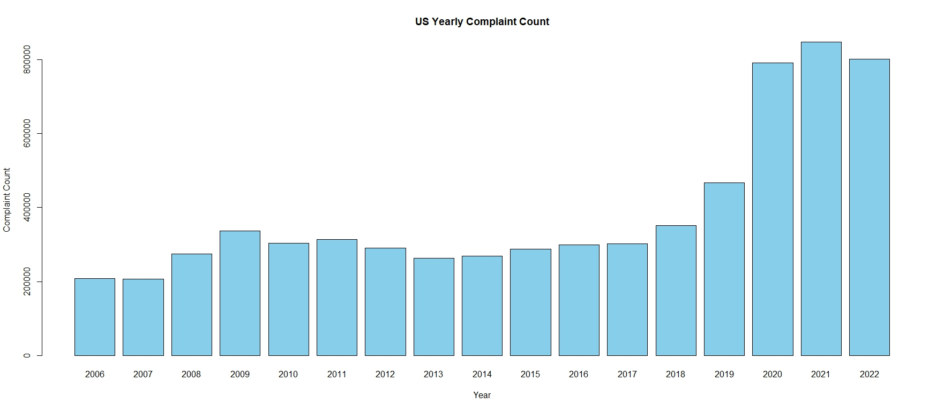
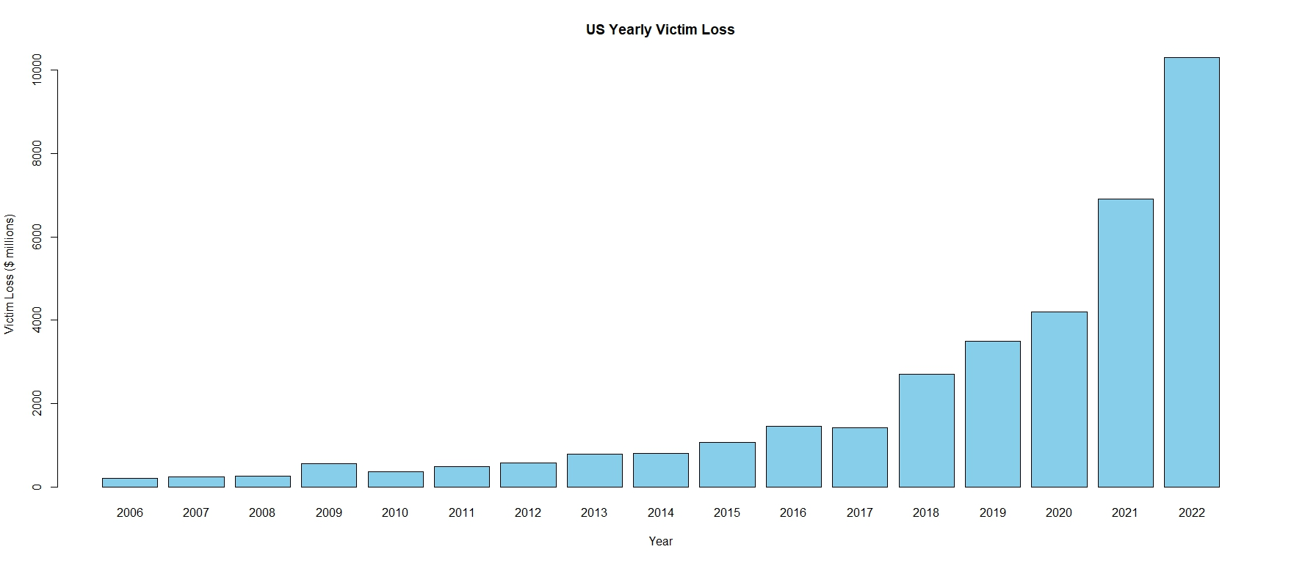
The bar graphs show the overall trend of cyber crime in the US
The expected increase in attacks is observed in the top graph
There is large expansion of attacks starting 2019 which coincides with the “work from home” requirement due to COVID
This indicates cyber attacks became more common as employees work remotely and are more prone to opening malware through email and other communications mediums
The loss due to cyber crime has exponentially grown in the same time period
As more purchases moved online, more opportunities for cyber crime to target the people
Non-Payment/Non-Delivery
Non-Payment/Non-Delivery
Non-Payment/Non-Delivery
Data Breach (Personal)

Slide 22
The bar graphs show the overall trend of cyber crime in the US
The expected increase in attacks is observed in the top graph
There is large expansion of attacks starting 2019 which coincides with the “work from home” requirement due to COVID
This indicates cyber attacks became more common as employees work remotely and are more prone to opening malware through email and other communications mediums
The loss due to cyber crime has exponentially grown in the same time period
As more purchases moved online, more opportunities for cyber crime to target the people
Non-Payment/Non-Delivery
Non-Payment/Non-Delivery
Non-Payment/Non-Delivery
Data Breach (Personal)
EDITED:

Slide 23
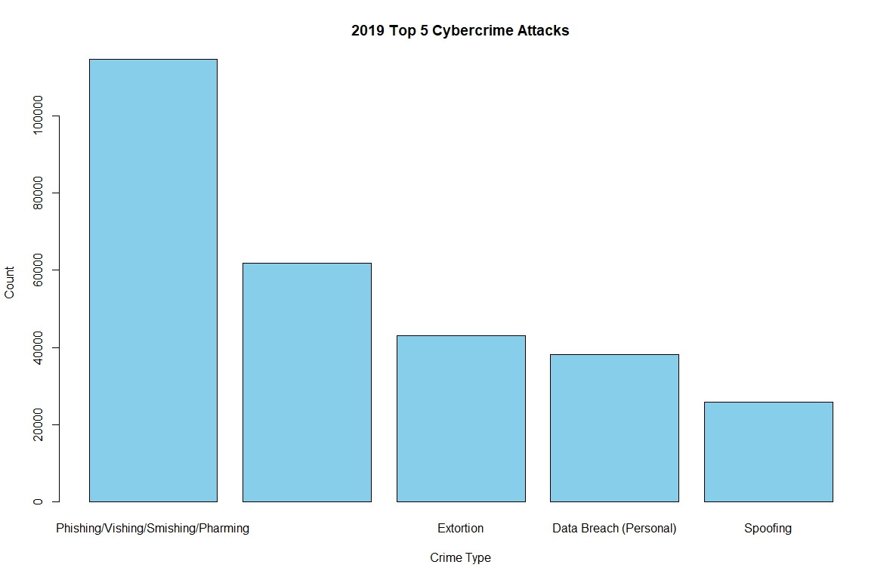
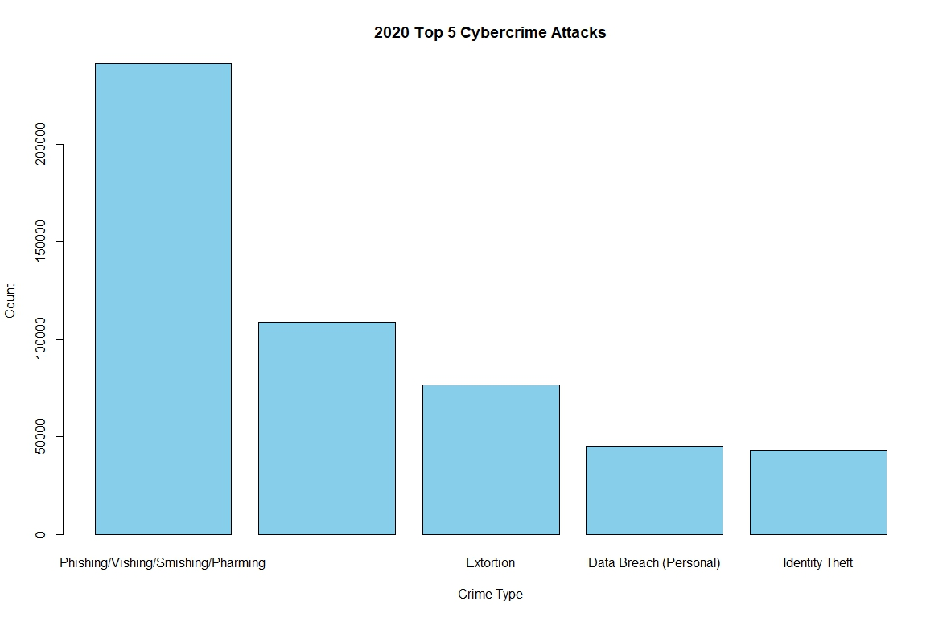
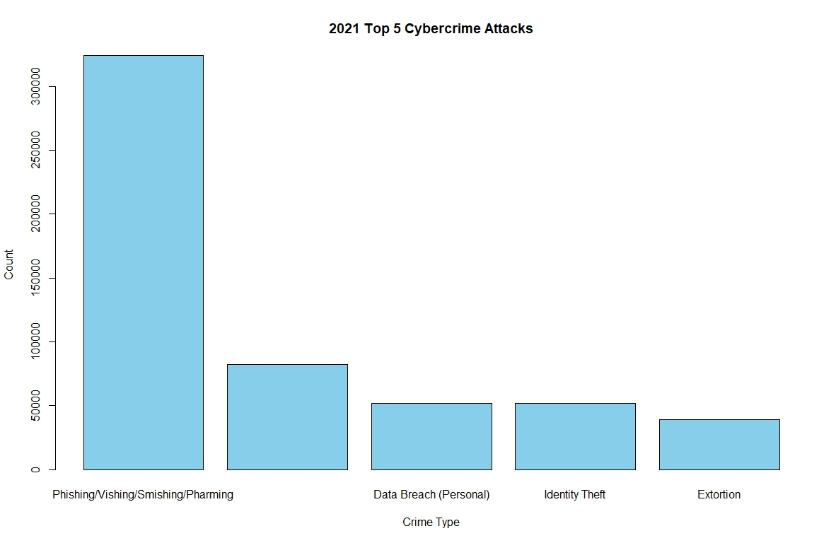
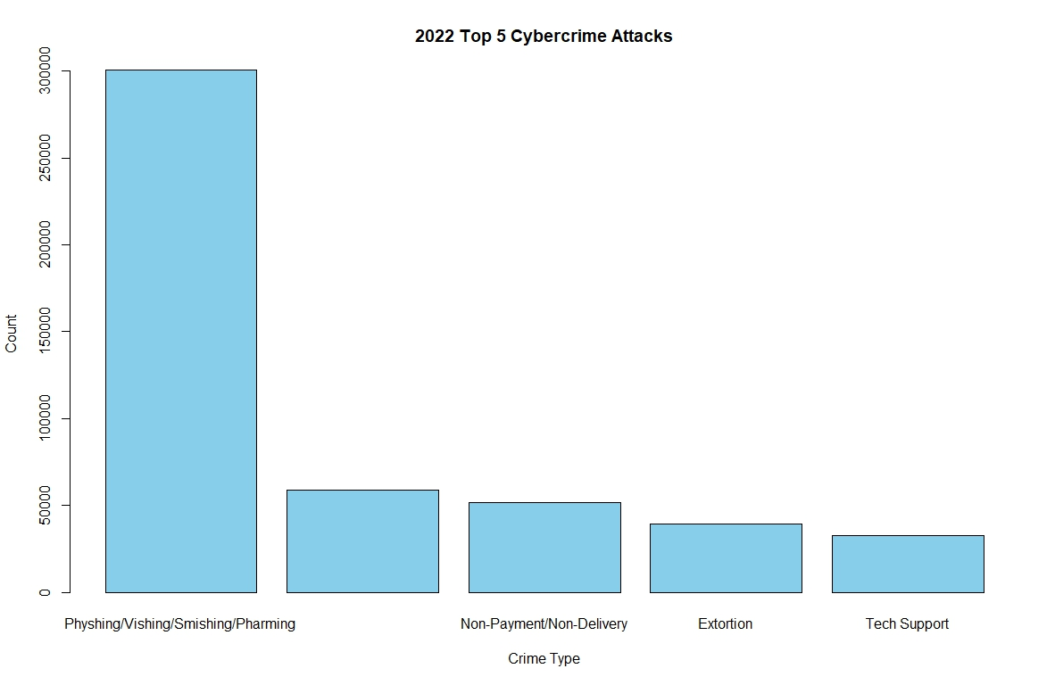
The bar graphs show the Top 5 cyber crime attacks for 2019 – 2022
The most common attack vector is Phishing and it’s different flavors
Other more common attacks include: Non-Payment/Non-Delivery, Data Breach (Personal), Spoofing, Identity Theft, Extortion, Tech Support
Phishing attacks are easy to conduct. They are characterized as fire and forget tools with some background research required for a successful targeted attack
Non-Payment/Non-Delivery
Non-Payment/Non-Delivery
Non-Payment/Non-Delivery
Data Breach (Personal)

Slide 24
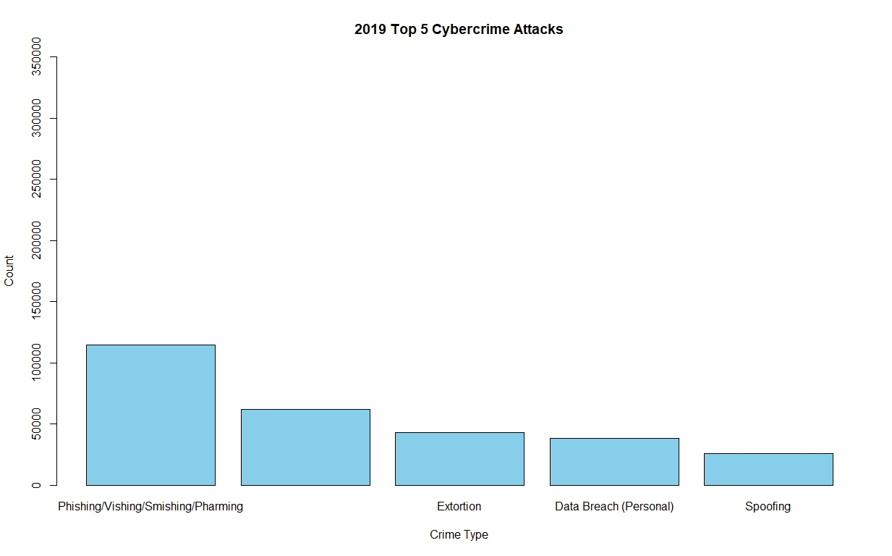
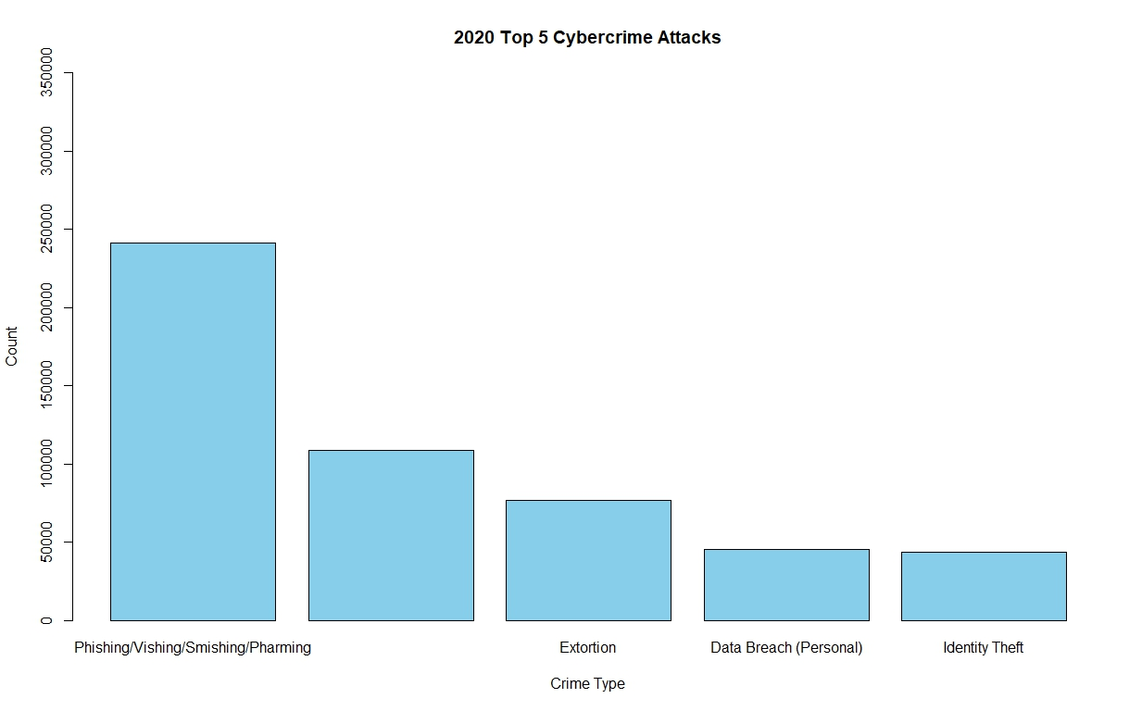
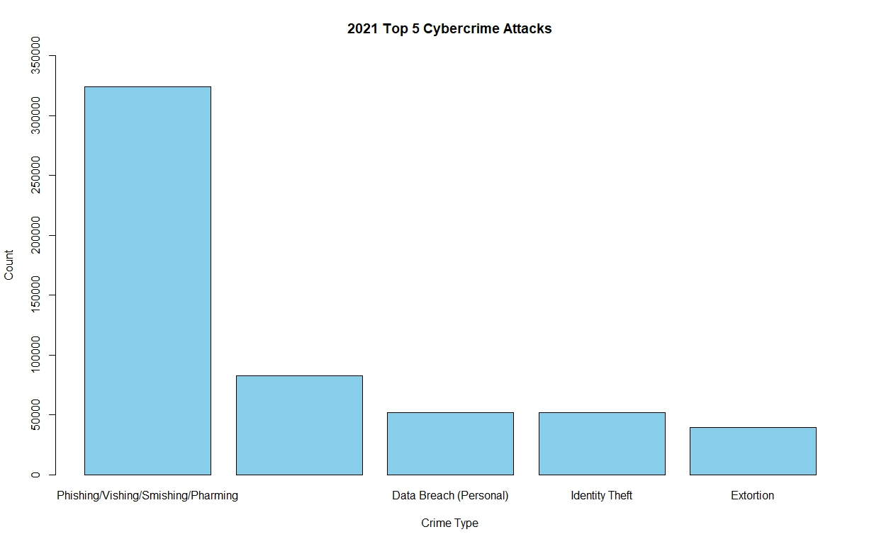
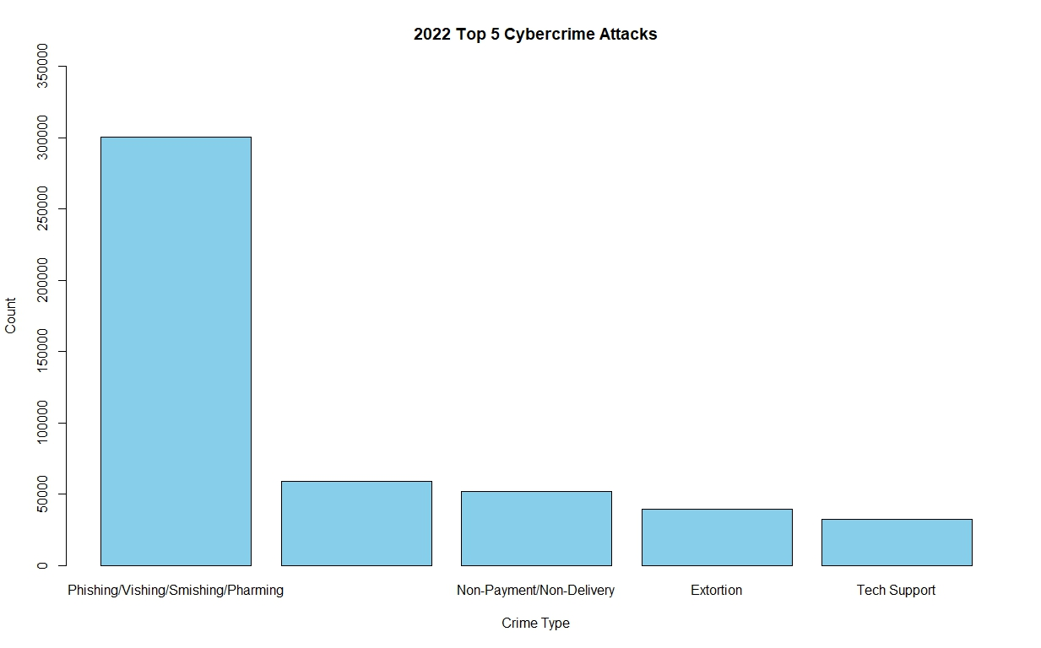
The bar graphs show the Top 5 cyber crime attacks for 2019 – 2022
The most common attack vector is Phishing and it’s different flavors
Other more common attacks include: Non-Payment/Non-Delivery, Data Breach (Personal), Spoofing, Identity Theft, Extortion, Tech Support
Phishing attacks are easy to conduct. They are characterized as fire and forget tools with some background research required for a successful targeted attack
Non-Payment/Non-Delivery
Non-Payment/Non-Delivery
Non-Payment/Non-Delivery
Data Breach (Personal)
EDITED:

Slide 25
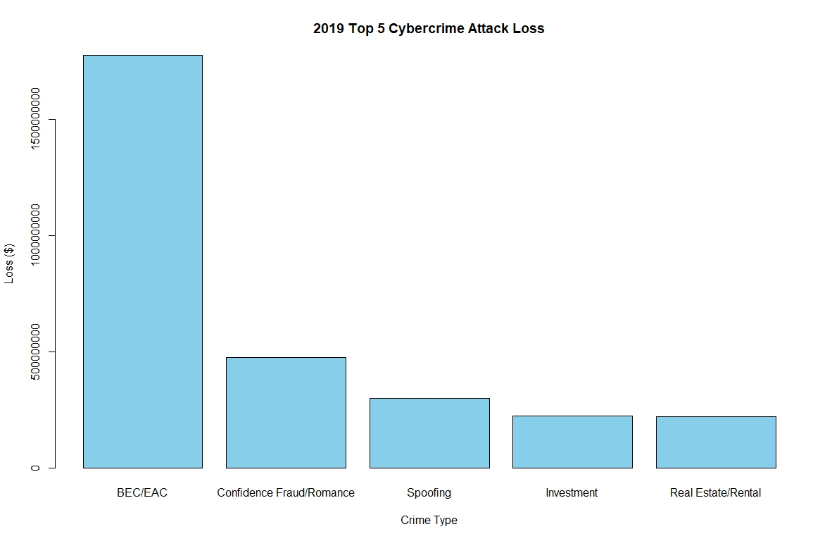
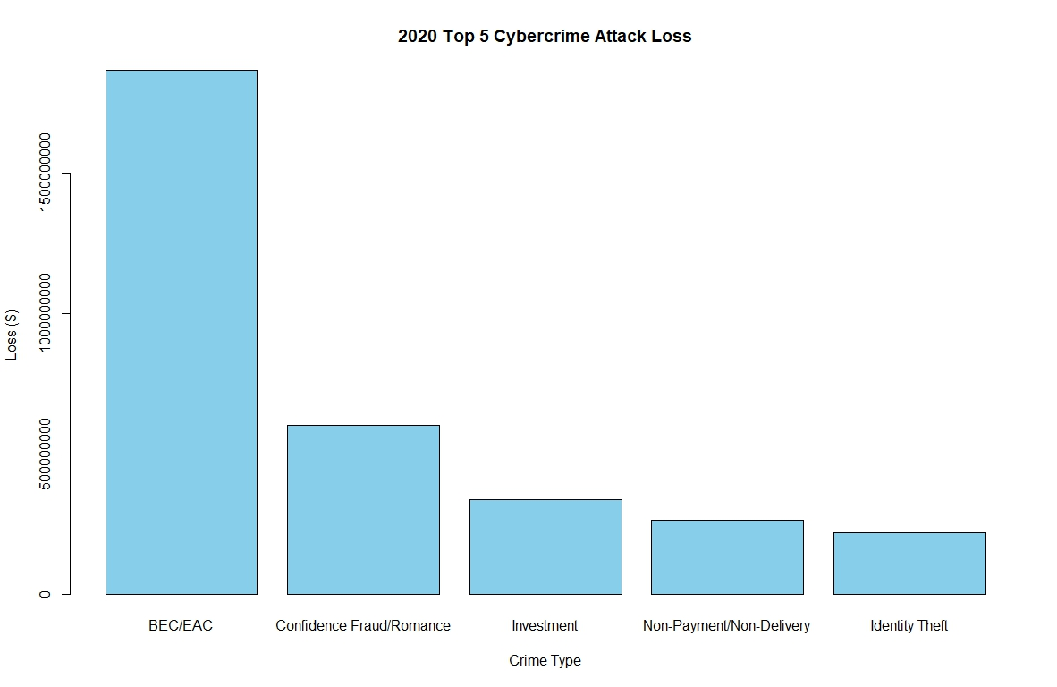
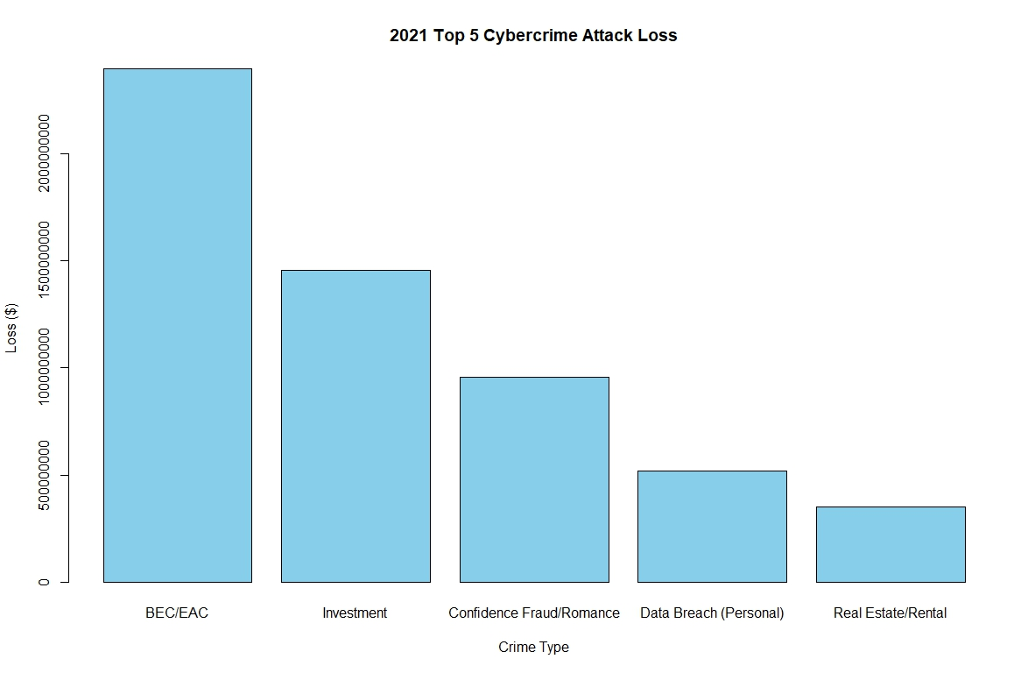
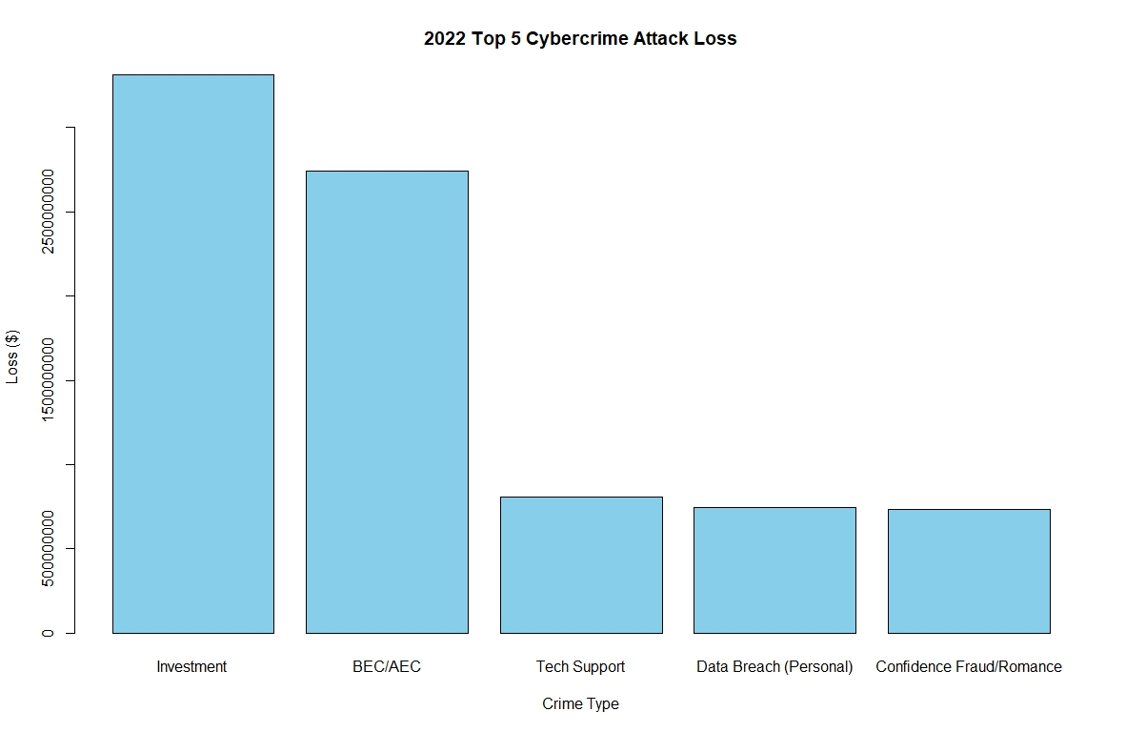
The bar graphs show the Top 5 cyber crime attack and associated loss in dollars for 2019 – 2022
Financial attacks are the most common which explains why the loss is the greatest
Take note that although Phishing is not the in the top 5 losses
However, Phishing is usually the first stage in a targeted attack where the victim can either have their credentials or their accounts compromised
These accounts can eventually lead to financial loss in any of the other categorized attacks
Data can be enriched by the FBI by documenting the attack chain used in a cyber attack
An attack chain lists the sequence of different attacks used to compromise a victim

Slide 26
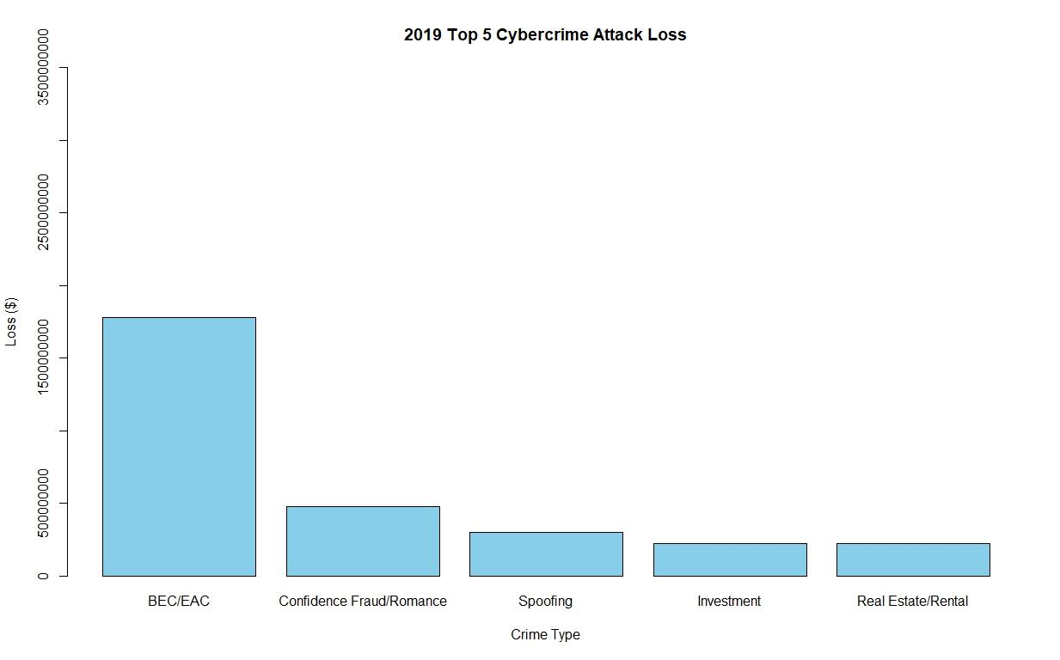
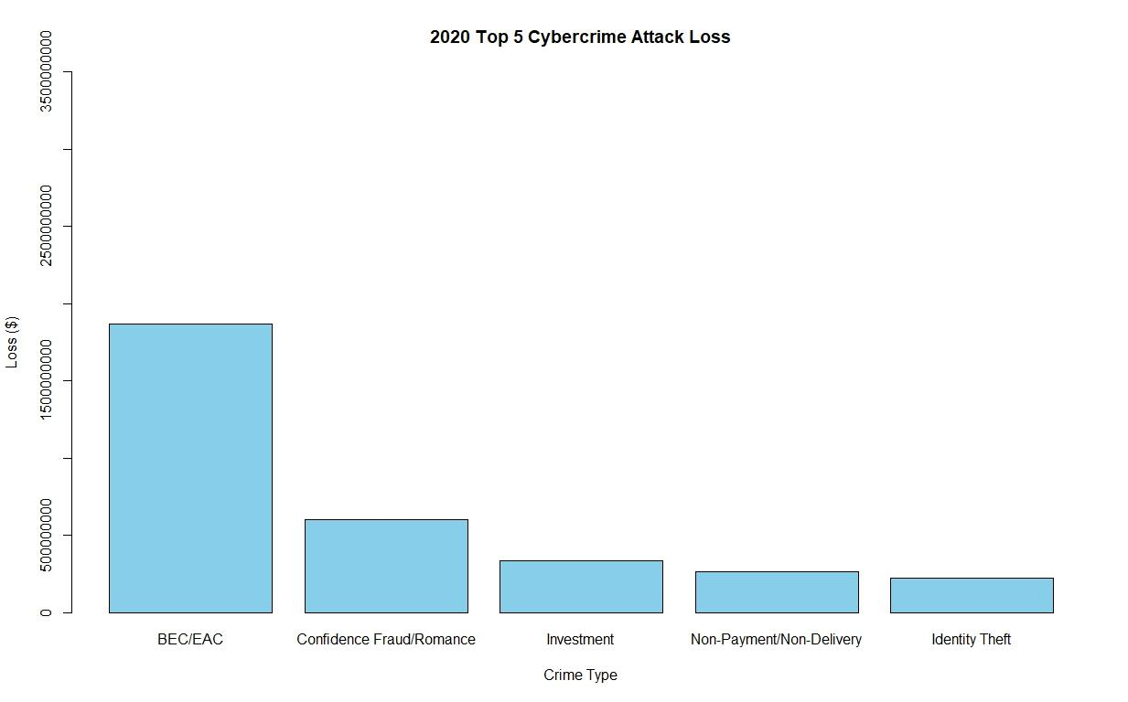
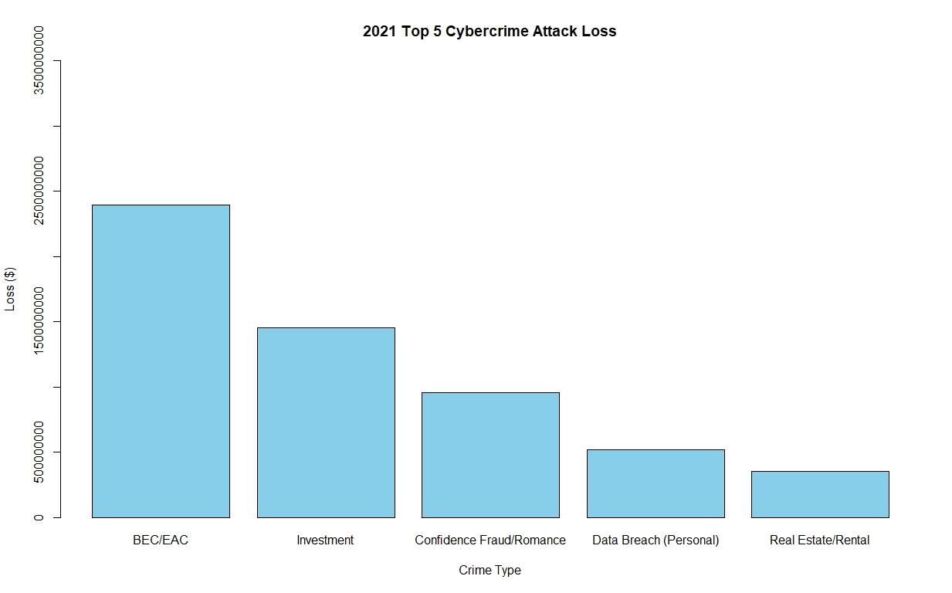
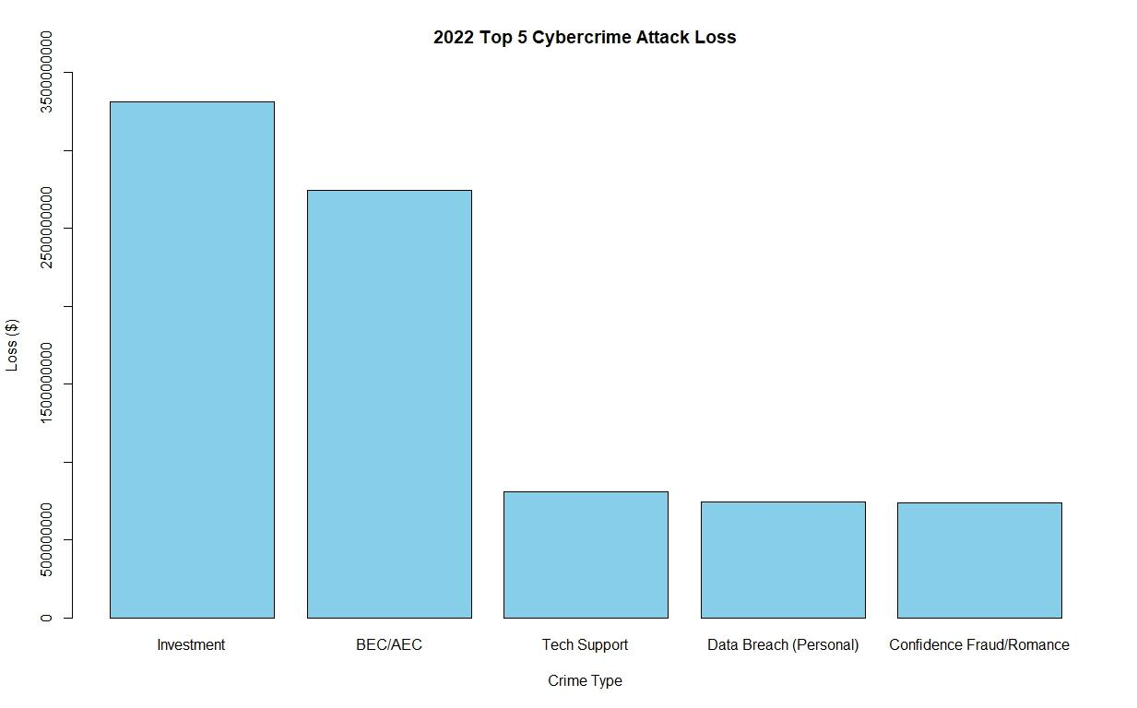
The bar graphs show the Top 5 cyber crime attack and associated loss in dollars for 2019 – 2022
Financial attacks are the most common which explains why the loss is the greatest
Take note that although Phishing is not the in the top 5 losses
However, Phishing is usually the first stage in a targeted attack where the victim can either have their credentials or their accounts compromised
These accounts can eventually lead to financial loss in any of the other categorized attacks
Data can be enriched by the FBI by documenting the attack chain used in a cyber attack
An attack chain lists the sequence of different attacks used to compromise a victim
EDITED:

Slide 27
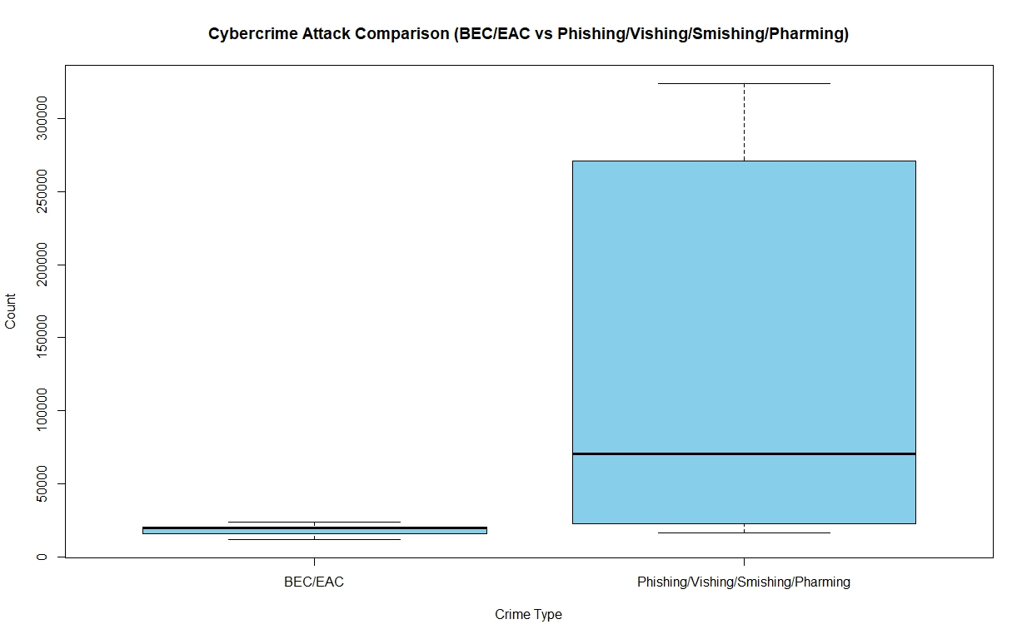
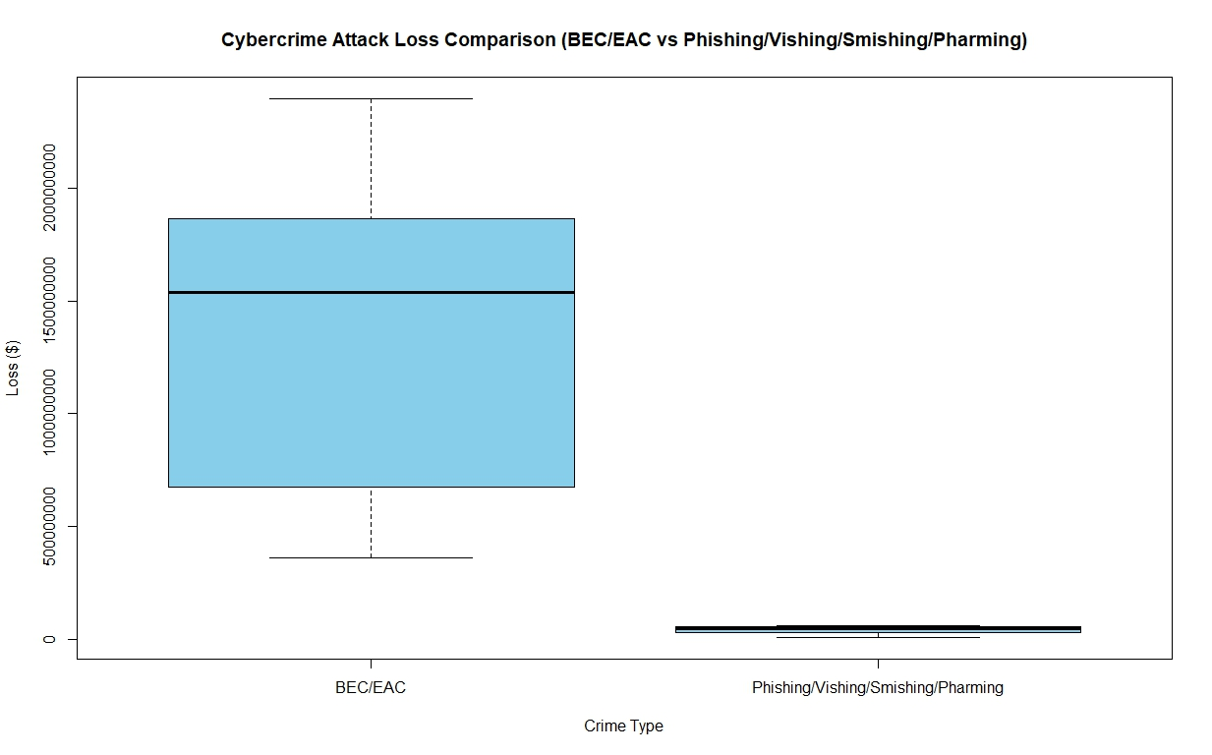
These boxplots attempt to contrast the top cybercrime attack with the top cybercrime loss.
Top Cybercrime attack is Phishing (and other flavors)
Top Cybercrime attack loss is BEC/EAC
Although Phishing accounted for the highest number of attacks it does not compare to BEC/EAC in terms of financial loss.
BEC or Business Email Compromise results in higher financial loss as the attackers try to conduct unauthorized transfer of funds from compromised users/businesses.
NOTE: Phishing can effect the acquisition of credentials which can lead to BEC instances.
Additional information to qualify the data is needed.
Attach chains need to be considered
EDITED:

Slide 28
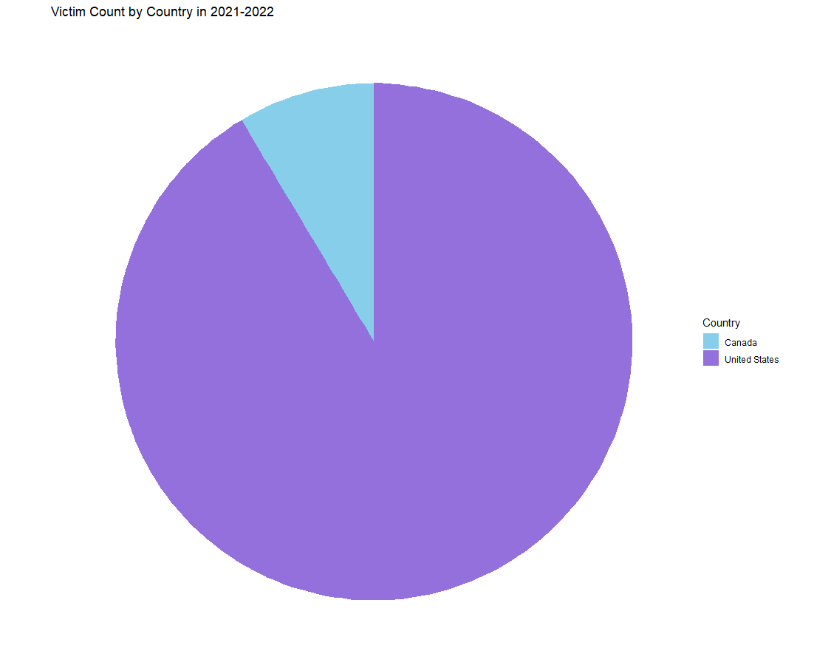
Phishing Incident Report: Victim Counts and Financial Losses in the United States and Canada (2021-2022)
The pie chart shows the number of victims in Canada and the U.S. for 2021-2022
The U.S. has a bigger slice of the pie, meaning more victims
Canada's slice is smaller, so it has fewer victims

Slide 29
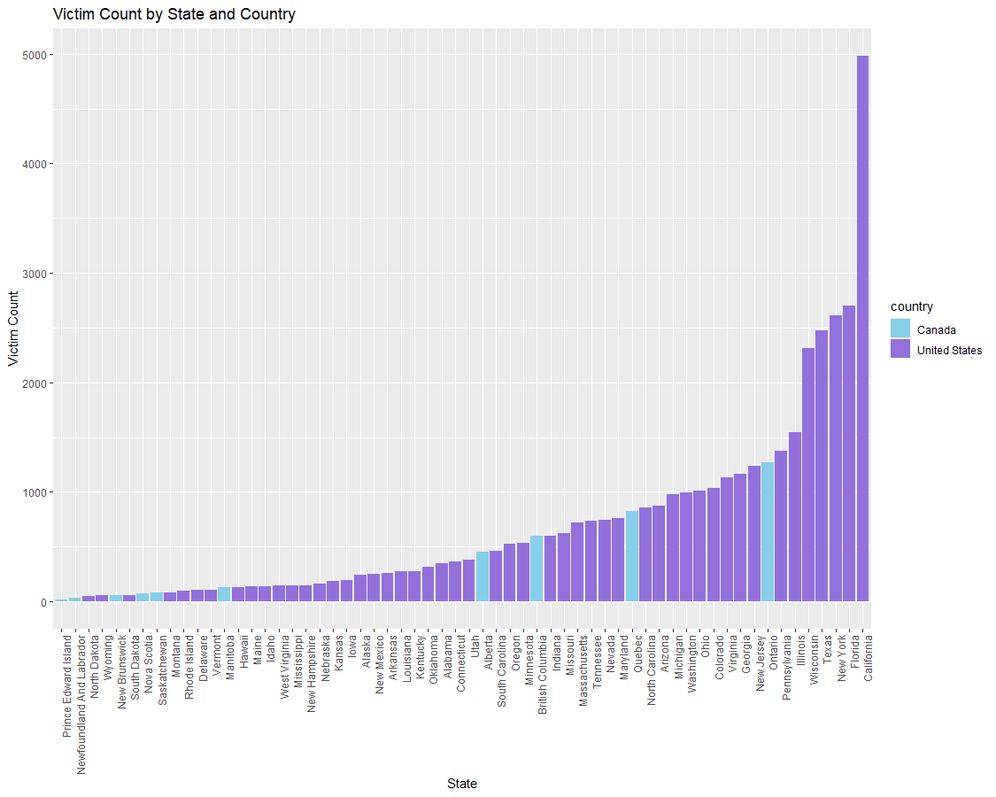
Phishing Incident Report: Victim Counts and Financial Losses in the United States and Canada (2021-2022)
The bar graph shows how many victims there are in each Canadian and U.S. state
States from both countries are shown as bars, where taller bars mean more victims
Bars are blue for Canada and purple for the U.S
The U.S. states usually have more victims than Canadian states
States with fewer victims are shown first, leading up to those with more
California has the most victims.
Canadian states have fewer victims overall, with Prince Edward Island having the least

Slide 30
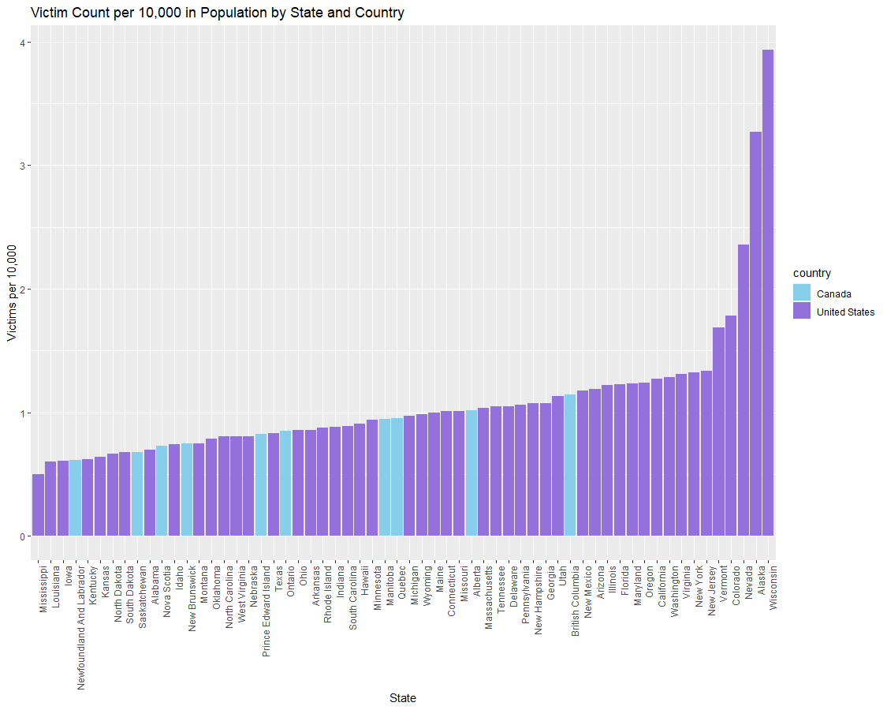
EDITED: Phishing Incident Report: Victim Counts and Financial Losses in the United States and Canada (2021-2022)
The bar graph shows the rate of victims per 10,000 people for various states within the United States and Canada.
The x-axis lists the states alphabetically, and the y-axis measures the victim count per 10,000 individuals.
The colors of the bars differentiate between two countries: the United States (in varying shades of purple) and Canada (in blue)
The original total victim count has been recalculated to a rate per 10,000 people, providing a proportionate comparison that accounts for the varying population sizes of each state.
This adjustment allows for a more equitable comparison of victim counts by normalizing the data, which is particularly useful in comparing states with large population differences such as California.

Slide 31
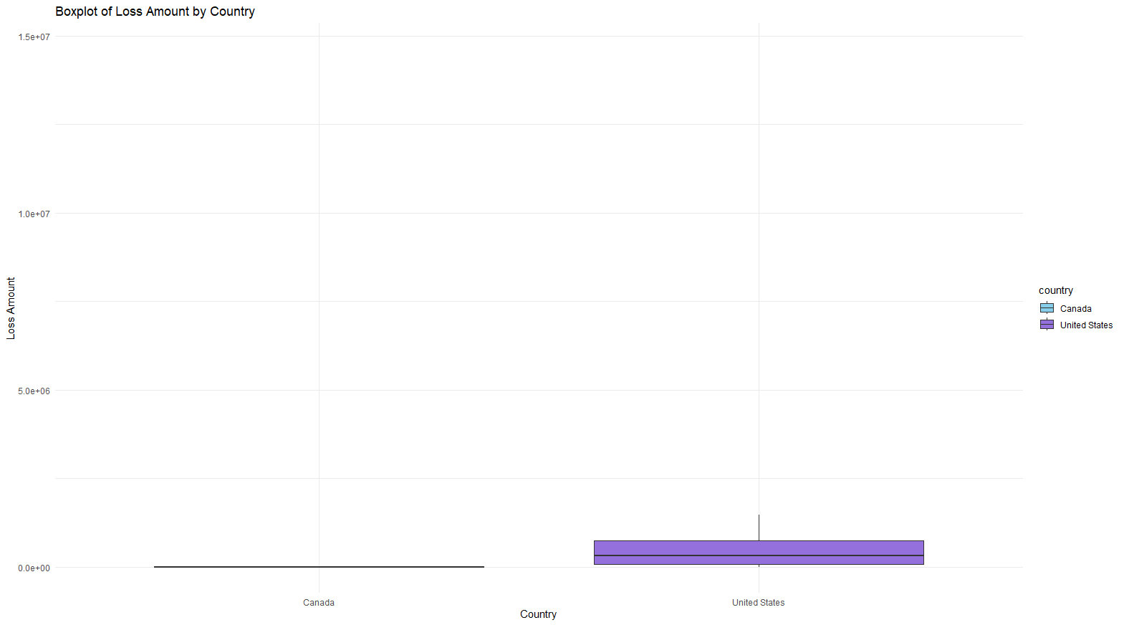
Phishing Incident Report: Victim Counts and Financial Losses in the United States and Canada (2021-2022)
The boxplot shows how much money was lost in Canada and the U.S
There's no visible loss for Canada, which might mean there wasn't much loss or the data is missing
The U.S. has a range of losses, mostly on the lower side, but some are higher

Slide 32
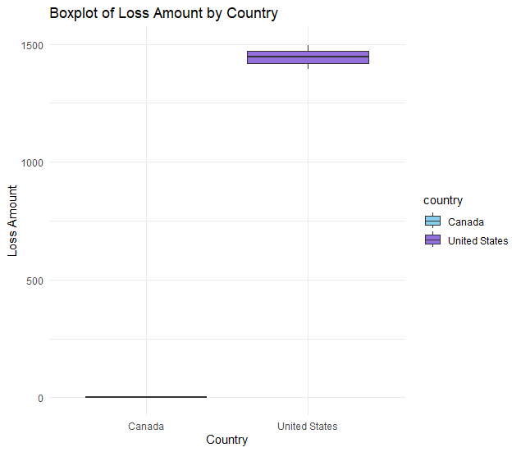
EDITED: Phishing Incident Report: Victim Counts and Financial Losses in the United States and Canada (2021-2022)
The boxplot shows how much money was lost in Canada and the U.S
Each country's distribution is represented by a single boxplot, with the United States' boxplot noticeably larger than Canada's, suggesting a higher range and possibly higher median values
Based on the feedback, the y-axis scale appeared to be very tall compared to the range of loss amounts, causing the boxplots to appear small and resulting in excessive white space on the graph. I adjusted the y-axis maximum limit to 1500 so I could provide a better visual representation by reducing this white space

Slide 33
Conclusion
How have cyber attacks patterns changed over the years?
During 2020 - 2022, there has been an increase in cyberattacks. This coincides with COVID-19 and many people starting to work from home
United States is the most targeted country
Phishing is the most popular attack
While phishing is the most popular attack, the financial losses are centered around financial based cyber attacks

Slide 34
Thank You
This concludes our presentation.

